Slide 1
July 2 Meeting Update
N3 – Invisible Institute
Akshay’s update

Slide 2
Outline
Crew Detection
Broad overview
Textual Analysis:
Methodology Review:
Topic Modeling
Sexual Violence Flagging
3 example crews

Slide 3
Crew Identification

Slide 4
Crew Generation
Created pseudo-probability index.
Based on:
Average Weighted Degree
Within Community Complaints
Internal Complaints Per Person
Jaccard Index with Label Propagation Community Detection
Percent of Officers who were “flagged” by classification
Each of these 5 variables were scaled to ensure equal impact
Any community with an index > 0.5 was a “Detected Crew”

Slide 5
160 Crews , 1,156 officers

Slide 6
They comprise less than 4% of all CPD officers…
Listed on 24% of all use of force complaints
Listed on 27% of all city payouts
Listed on 23% of all police shootings
Listed on 15% of all arrests between 2001 and 2018
Listed on 17% of complaints filed by Black individuals

Slide 7

Community 424 (C424) Crew Probability = 95.094%
Officers:
Jerome Turbyville, Patrick Thelan, Sean Ryan, Luis Jimenez, Daniel Gorman
Active years: Mostly between 1997-2002
District: 11
Total allegations: 281
Within-community-complaints: 58
27 were for use of force
10 were for illegal search
No available complainant information
Settlements: 4 (total of $142,500)
Media appearances:
Officer Sean Ryan pleaded guilty and was convicted for “selling a stolen assault rifle to a convicted cocaine dealer.” (Source)

Slide 8
Community 15 (C15) Crew Probability = 73.212%
Officers:
Anthony Bruno, Nicholas Duncan, Sergio Herrera, Salvador Lara, Titus Moore, Matthew Normand, Victor Razo, Roberto Sena, Brandon Ternand, Chris Williams, John Fazy, Andrew Janik
Active years: Mostly between 2011-2013
District: 3
Total allegations: 269
Within-community-complaints: 61
16 were for use of force
23 were for illegal search
53 of the 54 complaints with complainant info were filed by Black individuals
Settlements: 8 (total of $1,716,130)
Media appearances:
2020, Anthony Bruno told his team to “Kill the cams” during a raid on the wrong house. One of two similar incidents. (Source)

Slide 9
Community 413 (C413) Crew Probability = 53.707%
Officers:
Chris Marzano, Marc Delfavero, Terrence Julian, Ronald Mariani, Mark Mirabelli, Angel Amador
Active years: Mostly between 2001-2006
District: 1 (and Public Housing South)
Total allegations: 185
Within-community-complaints: 25
8 were for use of force
11 were for illegal search
No available complainant information
Settlements: 3 (total of $26,125)
Media appearances:
Chainsaw case (Source)
Trump protester (Source)

Slide 10
Textual Analysis

Slide 11
Issue:
There are likely aspects of complaints not adequately represented by the current categorization system.
For example, verbal abuse is likely present in many complaints, as is sexual harassment/violence which may not be reported
Question:
Can we identify some of these themes on a macro-level without reading each individual complaint?
Approach:
Topic Modeling

Slide 12
Methodology
Latent Dirichlet Allocation
Structural Topic Modeling
Flagging Key Words

Slide 13
Latent Dirichlet Allocation (LDA)
Entirely unsupervised
Need to specify number of topics
Assumes that every complaint contains a mixture of topics
Assumes that every word is probabilistically attributed to a topic
Only based on textual component of the complaint
This is what we previously did

Slide 14
Structural Topic Model (STM)
Framework is identical to LDA
We can use a combination of various metrics to identify the optimal number of topics
Accounts for metadata (ex. author’s name, etc.) to improve topic assignments
This is what we are now doing

Slide 15
Model Specifications
Topic prevalence is based on:
Number of officers listed on complaint
The beat where the complaint occurred
Whether the complaint was filed by a civilian or officer
Complainant race and gender
We purposely excluded ‘Category,’ ‘Allegation,’ and ‘Finding’
Potential variables to consider for improvement:
Time of day
Time of year

Slide 16

STM: Identified “optimal” K-value of 20

Slide 17
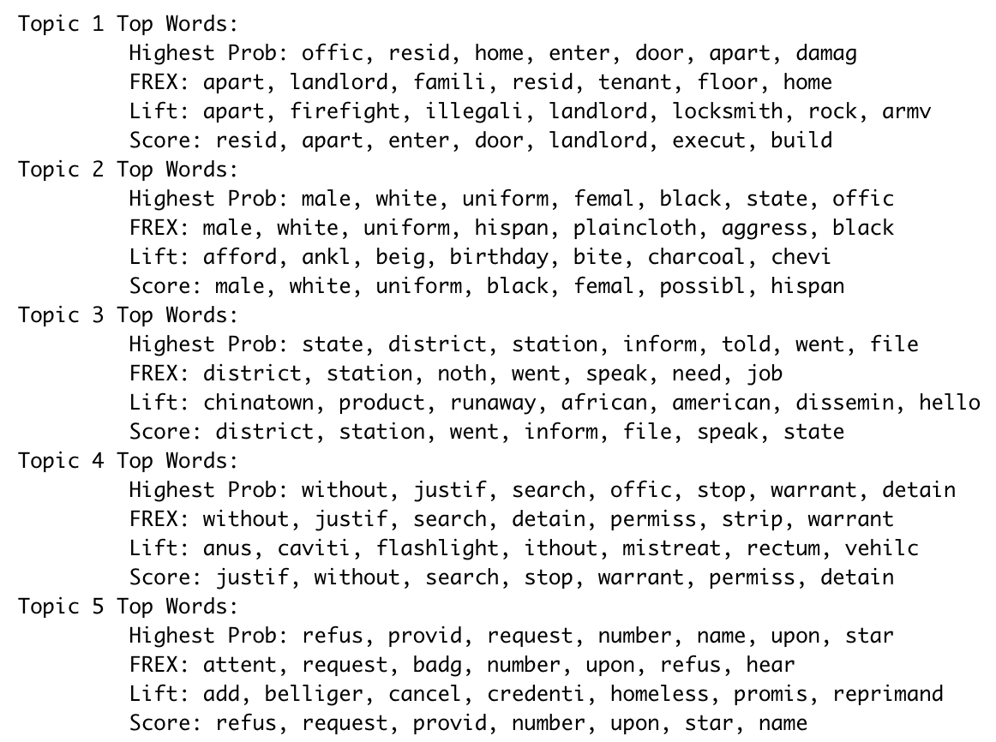

Slide 18
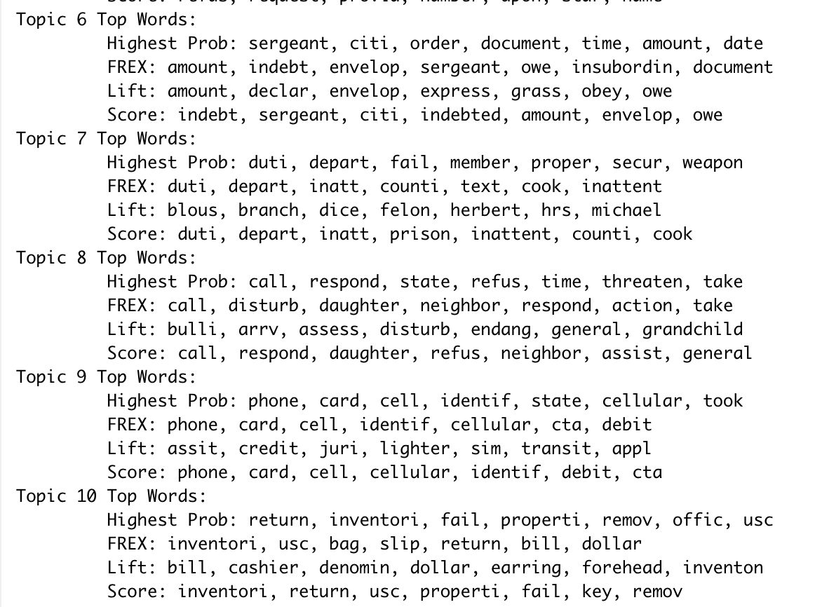

Slide 19
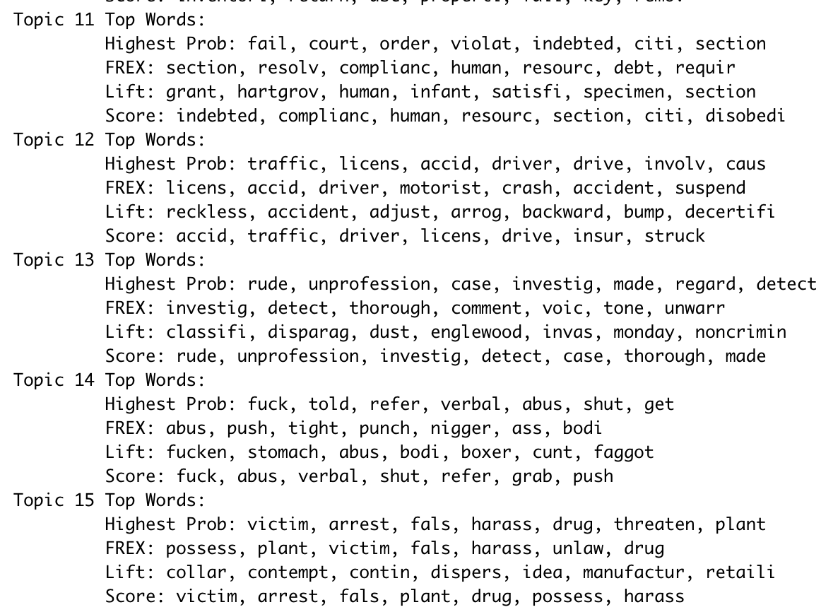

Slide 20
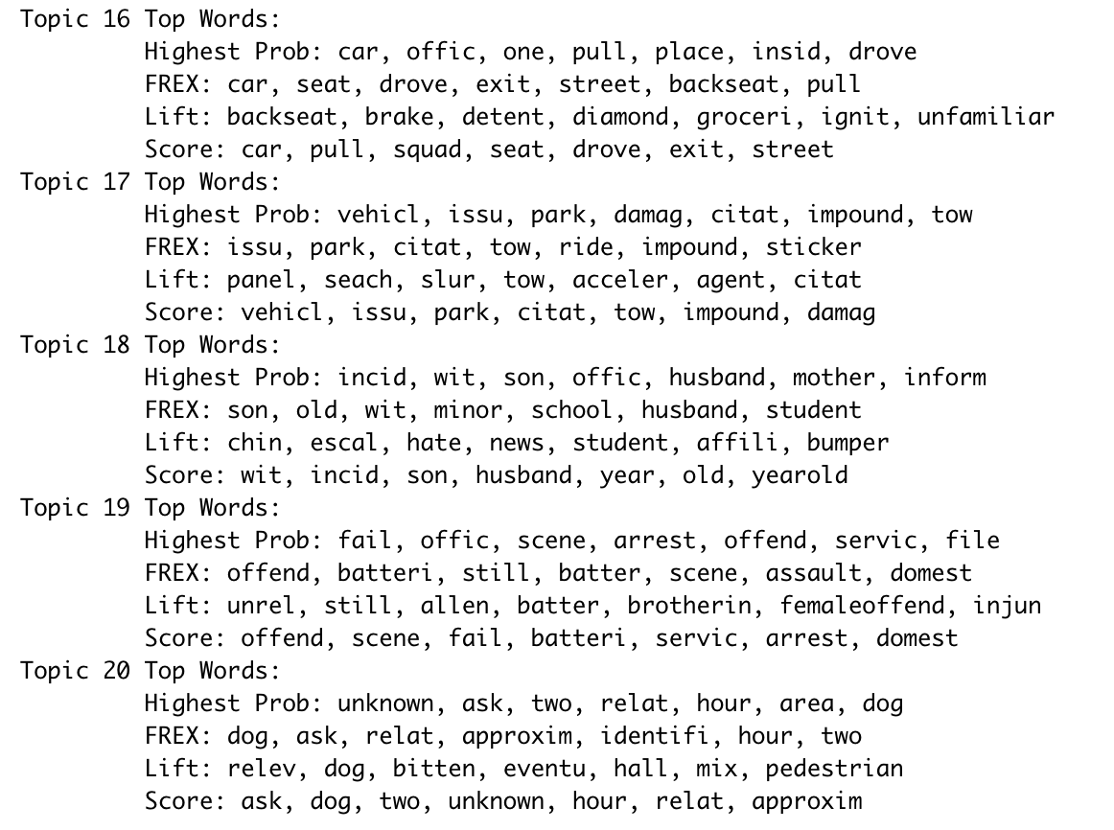

Slide 22
Topic 4 (Illegal Search/Detainment) Examples
“The complainant alleges that the accused officer detained her and her boyfriend without justification. The complainant alleges that the accused officer searched her and her boyfriend without justification.”
“The reporting party alleges that the accused stopped and searched him without justification. The reporting party alleges that the accused improperly searched him by rubbing his genitals and inserting his finger in his rectum. The reporting party also alleges that the accused stopped and searched him without justification.”
“The complainant alleged that the accused officers improperly searched him in his anal cavity.”

Slide 23
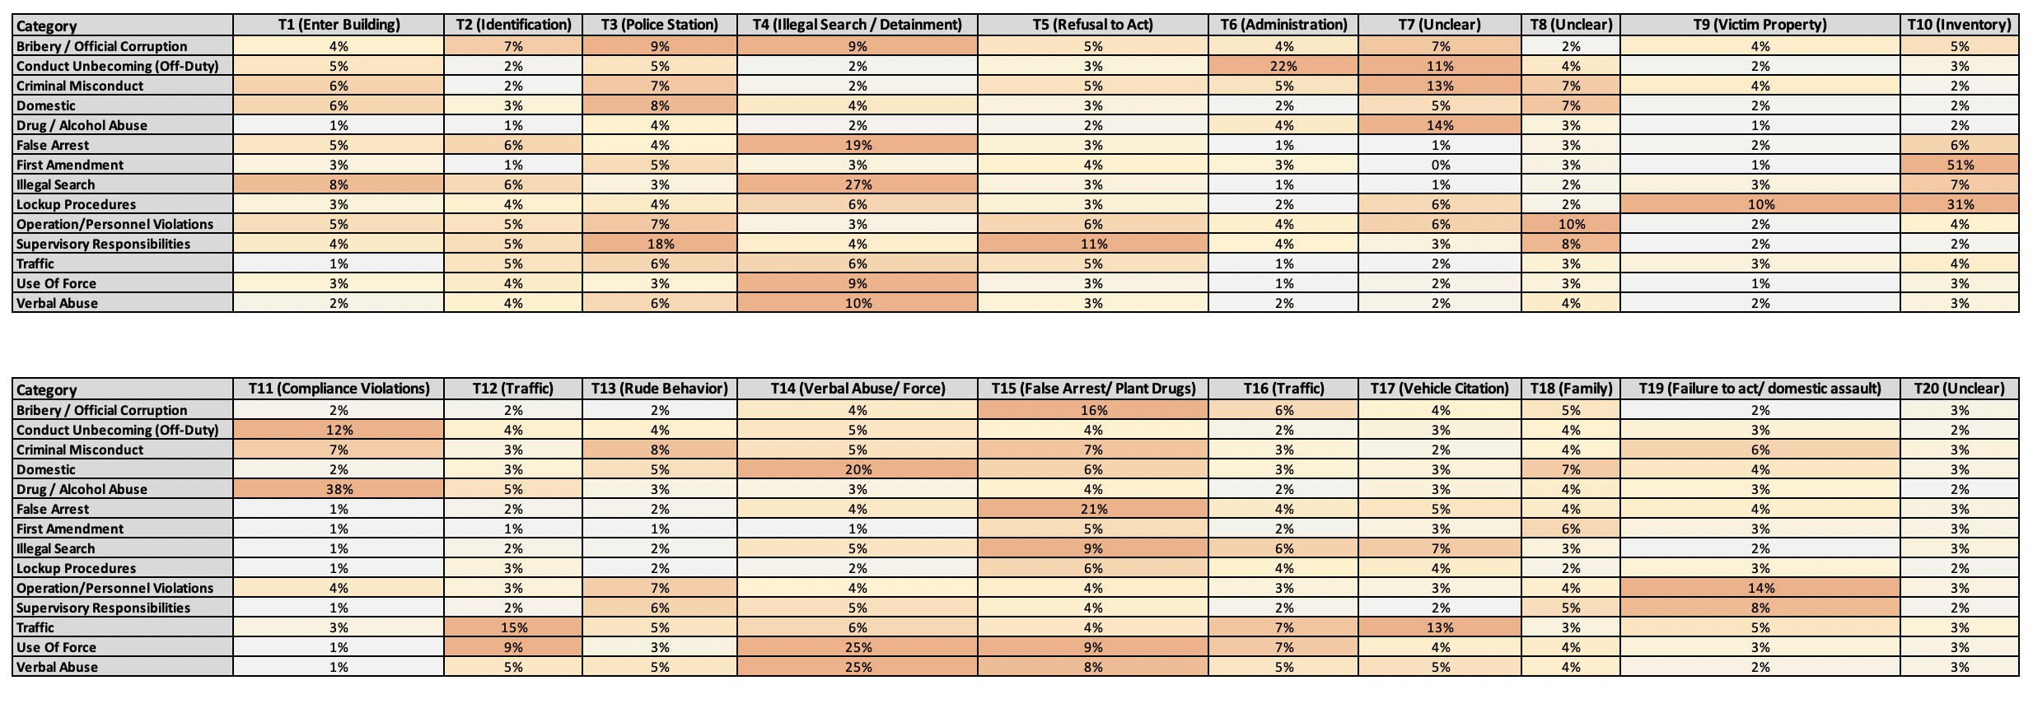
Big Idea: Most categories aren’t specifically attached to any topic, although you seem some moderate correlations

Slide 24
Are certain categories more related?
Use averaged topic assignments as a proxy for content
Notably high correlations:
Use of Force and Verbal Abuse - 96%
Lockup Procedures and First Amendment - 94%
Verbal Abuse and Domestic - 88%
Use of Force and Domestic - 83%
Illegal Search and False Arrest- 80%
False Arrest and Bribery/ Official Corruption - 79%

Slide 26
Flagging Key Words
Using pre-processing results, we can identify a list of ~2,500 “meaningful” words
Some of these words indicate a certain type of behavior. By flagging these words, we can create a non-ML, non-Robust, indicator model
Offers a foundation for building a training set
We focused on sexual violence

Slide 27
Sexual Violence
Key words:
"anus", "bra", "breast", "butt", "buttock", "caviti", "genit", "groin", "insert", "naked", "pant", "panti", "peni", "rectum","rub", "sex", "sexual", "strip", "vagina", "underwear", "undress", "unfasten", "unzip"
Found 173 of 4,759 complaints that contained at least one of these words
39% of these complainants are Black Males
28% are Black Females
9% are White Females
Only 9 (2.88%) of these complaints were sustained

Slide 31
So we have all this modeling… but what can we do with it??

Slide 32
Future directions
Goal:
Improve categorization and classification of complaints
Identify hidden themes and topics
Benefits:
Refine all future modeling based on categorization
Improve quality of information available to the public
Identify correlations with specific officers, victimization patterns, geographical trends, reporting habits, findings, etc.
Future modeling ideas:
Build semi-supervised model with a manually created training set
Markov models to identify unique authorship of complaint allegation to account for authorship variance (See: Using Markov Chains for Identification of Writers)

Slide 33

THANK YOU!!!

